Slide 1
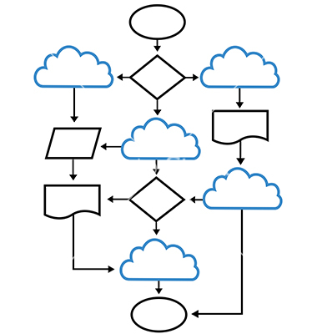
Optionally, one university or project logo may go in this space. Delete this box!
SaTC Project name
Objective & Challenge:
Key problem(s) to be addressed and their significance.
Hard problem to address and technical obstacles
Scientific Impact:
How might the project contribute to solutions to security/privacy problems?
How might the project improve the research community’s understanding of security or privacy
New knowledge gained
Approaches & Solution:
Technical approach, in brief
Highlight novelty and key innovations (new contributions)
Key breakthroughs
Broader Impact and Broader Participation:
What is the impact on society? Who will care?
Possible transition to practice?
Education and Outreach
Quantify impacts if possible
Graphical representation of your approach and its place within the broader application domain.
Project info (number, institution, contacts,...)
Notes:
SaTC is a multi-disciplinary program, and PI Meeting attendees include academics, industry professionals, government representatives, and others with wide-ranging expertise. Building continuing support for the SaTC program and growing the security and privacy research community requires that we convey the essence and broader impacts of SaTC-funded research to diverse stakeholders in a clear, concise, and visual way, quantifying impacts where possible. The summary slide should be understandable by the broader security and privacy research community, including those researchers that don’t work in your specific research domain.
Use this template as a guide to ensure your slide addresses the topics identified. This slide may be used to introduce your project and/or promote the SaTC program both within and outside NSF.

